Slide 1
GAUSSIAN MIXTURE MODEL (GMM)

Slide 2
Data Science Flow
Start!
1
Data Collection
Data Preprocessing
2
3
Feature Extraction, Transformation
Modeling
4
5
Testing
Evaluation
6
Result
Notes:
The EM algorithm application is Modelling step in the data science flow

Slide 3
Example in DRIVER RECOGNITION ARCHITECTURE
FEATURE EXTRACTION, FEATURE TRANSFORMATION
GMM (Gaussian Mixture Model)
HHT (Hilbert Huang Transformation)
PCA (Principal Component Analysis)
PRE-PROCESSING
Clock Synchronization
Delta Coefficient Calculation
Median Filter
Segment Partition (automatic)
Training Data Set
(Simulation & Real)
Raw Data
(Simulation)
Smartwatch sensor
Data Collection
Raw Data
(Real)
Testing data Data Set
(Simulation & Real)
TRAINING:
MODELING
- SVM
TESTING (DECISION)
Authentication
Identification
Safe/unsafe driving
model
PERFORMANCE EVALUATION
FAR, FRR, EER, DET CURVE
result
conclusions

Slide 4
Feature Extraction
Learned Previously:
Learn on This Session:
Histogram
Earth Movement Distance
K-Means Clustering
Kernel Mapping
…
GMM
HHT
PCA

Slide 5
Feature Extraction
Learned Previously:
Learned on This Session:
Histogram
Earth Movement Distance
K-Means Clustering
Kernel Mapping
GMM
HHT
PCA

Slide 6
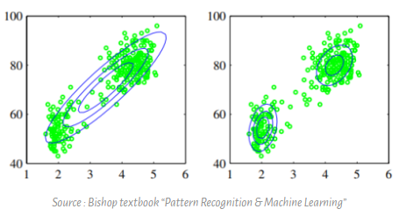
Why we use GMM
In reality (for example: driving behavior), sometimes we cannot model the probability distribution using single Gaussian model.
We need to use linear combination of Gaussian distribution => GMM
Notes:
Picture in the left, the green dots are an example of given data that cannot (will be bad) be modeled using single Gaussian distribution, because it has two summits. To model green dots distributions, we can use linear combination of Gaussian distributions (picture in the right), which is much better than single Gaussian distribution. This model combination of Gaussian is usually called GMM (Gaussian Mixture Model)

Slide 7
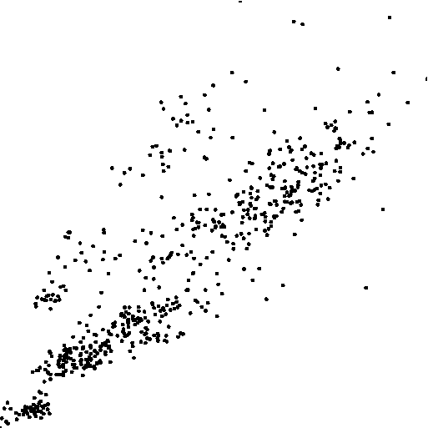
Raw data

Slide 8
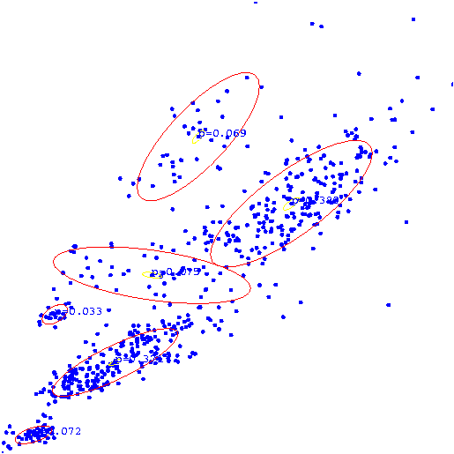
Using GMM

Slide 9
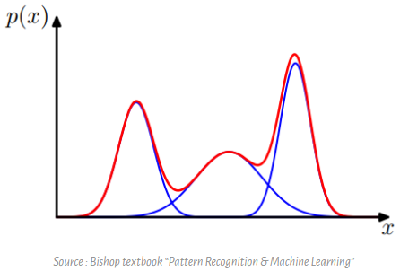
What is GMM
GAUSSIAN MIXTURE MODEL: in one dimension
Notes:
A Gaussian mixture model is a probabilistic model that assumes all the data points are generated from a mixture of a finite number of Gaussian distributions with unknown parameters

Slide 10
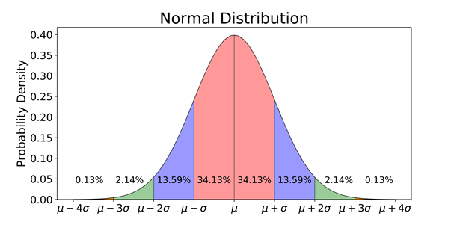
Normal (Gaussian) Distribution
a type of continuous probability distribution for a real-valued random variable.
*probability density function: density of a continuous random variable
Notes:
The parameter $μ$ (mu) is the mean or expectation of the distribution (and also its median and mode), while the parameter $σ$ (sigma) is its standard deviation.[1] The variance of the distribution is $σ^{2}$ sigma square.

Slide 11

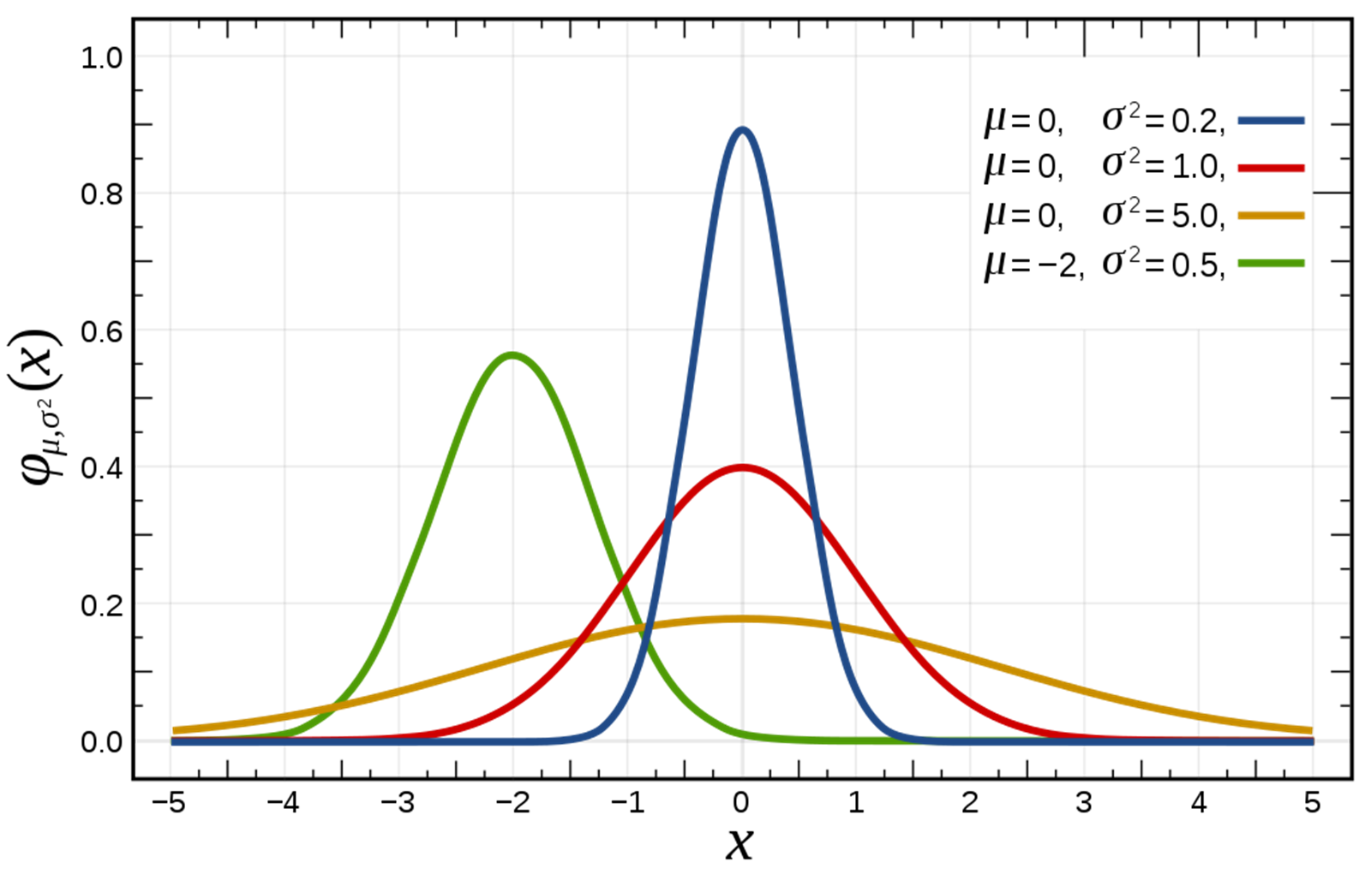
Normal (Gaussian) Distribution
In GMM
a random variable
Normalized Gaussian curves
with expected value μ and variance σ2

Slide 12
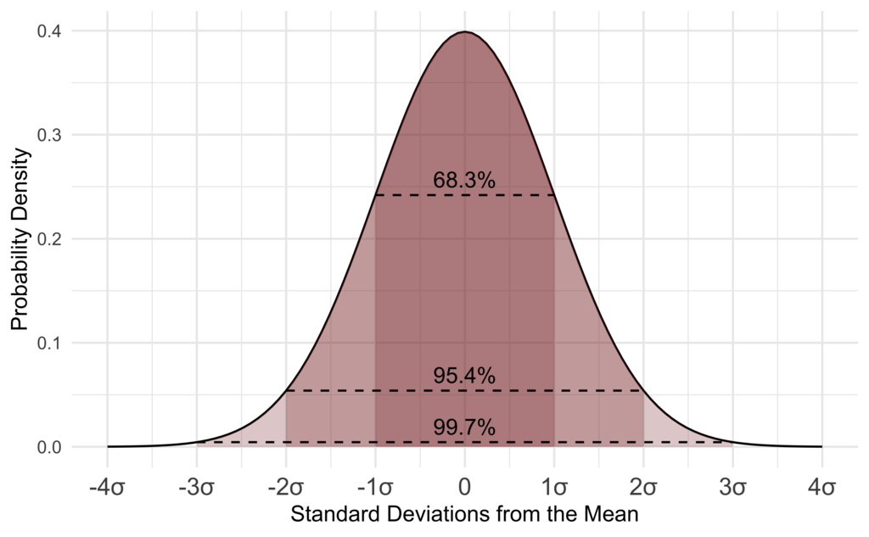
Gaussian
In probability theory, the central limit theorem (CLT) establishes that, in many situations, when independent random variables are added, their properly normalized sum tends toward a normal distribution (informally a bell curve) even if the original variables themselves are not normally distributed. The theorem is a key concept in probability theory because it implies that probabilistic and statistical methods that work for normal distributions can be applicable to many problems involving other types of distributions.
in probability theory, a probability density function (PDF), or density of a continuous random variable, is a function whose value at any given sample (or point) in the sample space (the set of possible values taken by the random variable) can be interpreted as providing a relative likelihood that the value of the random variable would equal that sample.[
The normal distribution, a very common probability density, useful because of the central limit theorem.

Slide 13
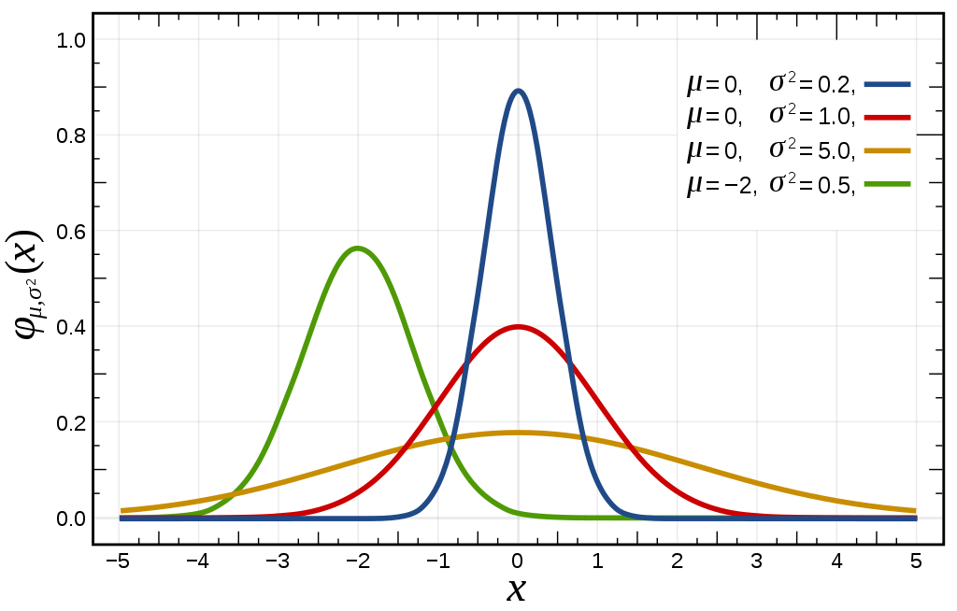

Normalized Gaussian curves with expected value μ and variance σ2. The corresponding parameters are {\displaystyle a={\tfrac {1}{\sigma {\sqrt {2\pi }}}}}a={\tfrac {1}{\sigma {\sqrt {2\pi }}}}, b = μ and c = σ

Slide 14
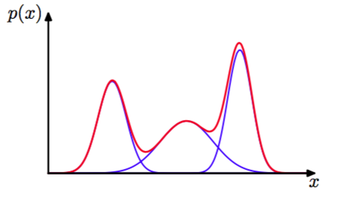
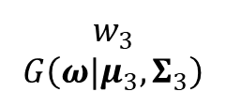
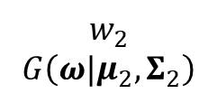
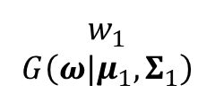

Gaussian Mixture Model (GMM)
$$θ=\left\{w_{i},{\vec{μ}}_{i},Σ_{i}\right\}, i=1,…,3$$
form new distribution (red line) by combining three Gaussian distribution (blue line)
$$w_{1}$$
$$G\left(ω|μ_{1},Σ_{1}\right)$$
$$w_{2}$$
$$G\left(ω|μ_{2},Σ_{2}\right)$$
$$w_{3}$$
$$G\left(ω|μ_{3},Σ_{3}\right)$$
Probability density function for Gaussian mixture distribution
Density function of the multivariate normal distribution

Slide 15
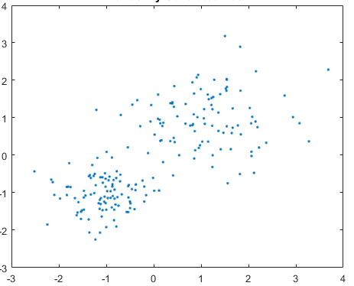
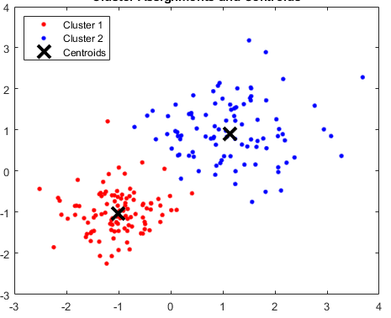
How to apply GMM (matlab)
Signal
cNum
Combine region
Convert the contents of a cell array into a single matrix
kMeans
Partitions points in data matrix into k cluster
gmDistribution.fit
consist of a mixture of one or more multivariate Gaussian distribution
llh/pp
Log-likelihood and/or posterior probability value, depend on

Slide 16

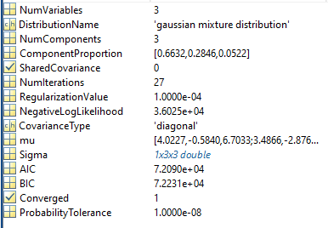
Data Structure
signalLeft
Left_rawSignalData.Driver 1.AccX
region | 700 - 900 (data captured)
1 | 3.5378 | 3.5378 | 3.614396 | 3.614396 | 3.623971 | …
2 | 1.680335 | 1.680335 | 1.680335 | 1.680335 | 1.680335 | …
3 | 3.317585 | 3.365458 | 3.375032 | 3.375032 | 3.422905 | …
… |  |  |  |  |  | …
265 | 2.283533 | 2.331405 | 2.360129 | 2.360129 | 2.360129 | …
X | 4.485681 | 4.50483 | 4.552703 | 4.552703 | 4.600576 | …
Y | -0.70444 | -0.70444 | -0.70444 | -0.70444 | -0.70444 | …
Z | 5.93144 | 5.921865 | 5.921865 | 5.921865 | 5.873993 | …
signalright
X | 3.64312 | 3.623971 | 3.585673 | 3.585673 | 3.547374 | ….
Y | -1.11909 | -1.11909 | -1.11909 | -1.11909 | -1.11909 | ….
Z | 6.458041 | 6.458041 | 6.438892 | 6.438892 | 6.419742 | …..
Left_rawSignalData.Driver 2.AccX
region | 700 - 900 (data captured)
1 | 3.5378 | 3.5378 | 3.614396 | 3.614396 | 3.623971 | …
2 | 1.680335 | 1.680335 | 1.680335 | 1.680335 | 1.680335 | …
3 | 3.317585 | 3.365458 | 3.375032 | 3.375032 | 3.422905 | …
… |  |  |  |  |  | …
265 | 2.283533 | 2.331405 | 2.360129 | 2.360129 | 2.360129 | …
Combine region
signalstraight
X | 3.317585 | 3.365458 | 3.375032 | 3.375032 | 3.422905 | …
Y | -2.44995 | -2.44038 | -2.44038 | -2.44038 | -2.44038 | …
Z | 5.136751 | 5.136751 | 5.136751 | 5.136751 | 5.136751 | …
Left_rawSignalData.Driver 1.AccY
region | 700 - 900 (data captured)
1 | 3.5378 | 3.5378 | 3.614396 | 3.614396 | 3.623971 | …
2 | 1.680335 | 1.680335 | 1.680335 | 1.680335 | 1.680335 | …
3 | 3.317585 | 3.365458 | 3.375032 | 3.375032 | 3.422905 | …
… |  |  |  |  |  | …
265 | 2.283533 | 2.331405 | 2.360129 | 2.360129 | 2.360129 | …
llh leftTurning
llh.rightTurning
llh.straight
……………….. ((driver 1, Driver 2,..), (leftTurn, straight, rightTurn), (AccX, AccY,..))
region
1 |  |  |  |  |  | …
2 |  |  |  |  |  | …
3 |  |  |  |  |  | …
… |  |  |  |  |  | …

Slide 17
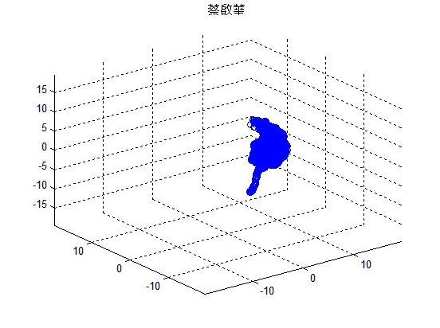
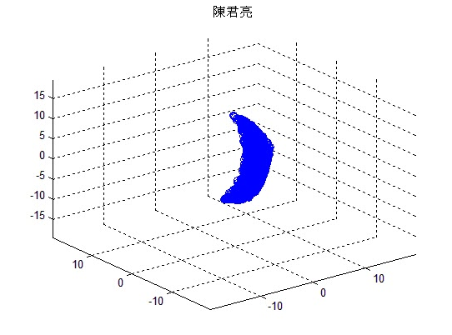
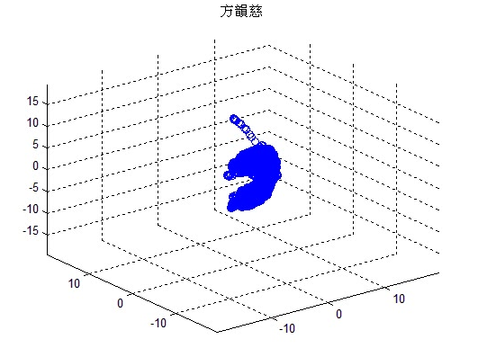


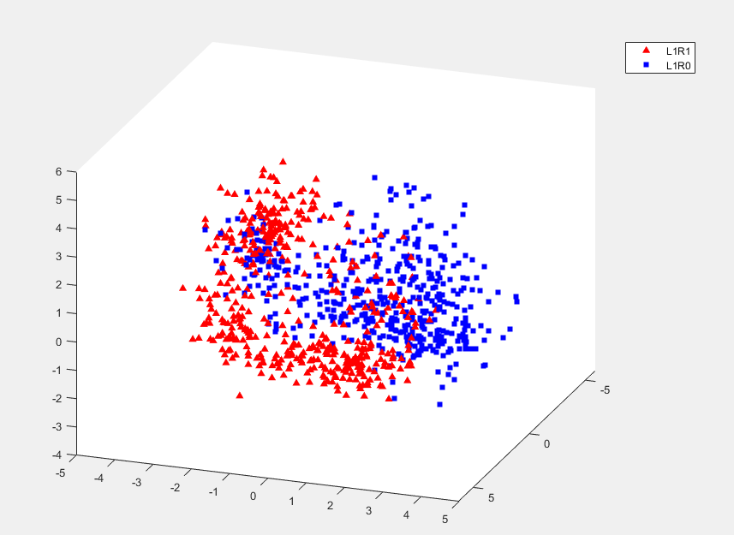
GMM Implementation example (in driver recognition case)
In driver Recognition case, proven that GMM-based modeling approach produce a good authentication., identification
The feature induce a good model.
Raw signal
Driver X? Y/N
DRIVER AUTHENTICATION
[YCL18] Ching-Han Yang, Chin-Chun Chang, Deron Liang (2018) “A Novel GMM-Based Behavioral Modeling Approach for Smartwatch-Based Driver Authentication”, Sensors, Volume 18, Issue 4, March 2018. (SCI)
Which Driver? A? B? C? D? or Unknown?
DRIVER IDENTIFICATION
[RCC21] Rekyan Regasari Mardi Putri, Ching-Han Yang, Chin-Chun Chang, Deron Liang (2020) “Smartwatch-based Open-set Driver Identification by Using GMM-based Behavior Modeling Approach”. in IEEE Sensors Journal, February 2021. (SCI)
Article link:
https://isslab.csie.ncu.edu.tw/en/results.html

Slide 18
GMM’s Summarize
- what is GMM
a single distribution combined from n distribution
- why we use GMM
when the signal’s probability distribution that we used,
cannot representated by a single Gaussian model
- how is GMM work
Convert into single matrix → partity into k cluster →
Gaussian mixture distribution class
(use “gmDistribution.fit” on matlab)

